Slide 1
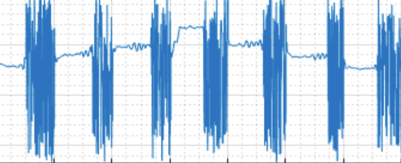
Real-Time Audio Spoofing Detection

Slide 2
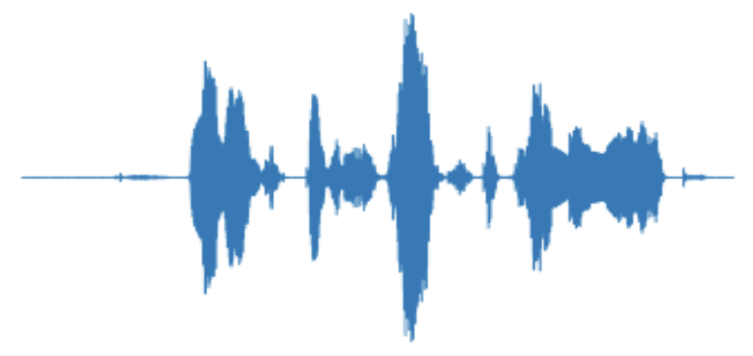
Team
S. Kalyana Venkat 21MID0210
V. Dhanvarshini 21MID0144
K. Sujith Kumar 21MID0179
B. Siva Sahithi 21MID0145

Slide 3
Introduction
Spoofing attacks, which involve impersonating others for malicious purposes, have become a growing concern in the realm of audio. Researchers have proposed real-time audio spoofing detection using neural networks, specifically convolutional recurrent neural networks (CRNN), to analyse the features of the audio signal and classify it as genuine or fake. Features such as pitch, kurtosis, and Mel-frequency cepstral coefficients (MFCC) can be used to detect audio spoofing. These features can be inputted into the CRNN model, allowing the network to accurately detect audio spoofing in real-time.
The use of neural networks and advanced audio analysis techniques holds great promise in defending against audio imposters and ensuring the integrity of audio recordings. However, real-time audio spoofing detection requires fast and efficient processing of the audio signal, and the model can adapt and learn from new data, continuously improving its accuracy over time.

Slide 4

Abstract
The paper "Defending Against Imposters: A Neural Network Approach to Real-Time Audio Spoofing Detection" proposes a solution to the growing problem of audio spoofing attacks, which aim to bypass speaker verification systems by playing pre-recorded or synthesized audio of the target speaker. This paper proposes a neural network approach to real-time audio spoofing detection using a convolutional recurrent neural network (CRNN) and a range of audio features, including pitch, kurtosis, and Mel-frequency cepstral coefficients (MFCC). The audio features are extracted from the input audio signal using signal processing techniques, including pitch estimation, kurtosis analysis, and MFCC calculation.

Slide 5
LITERATURE SURVEY

Slide 6
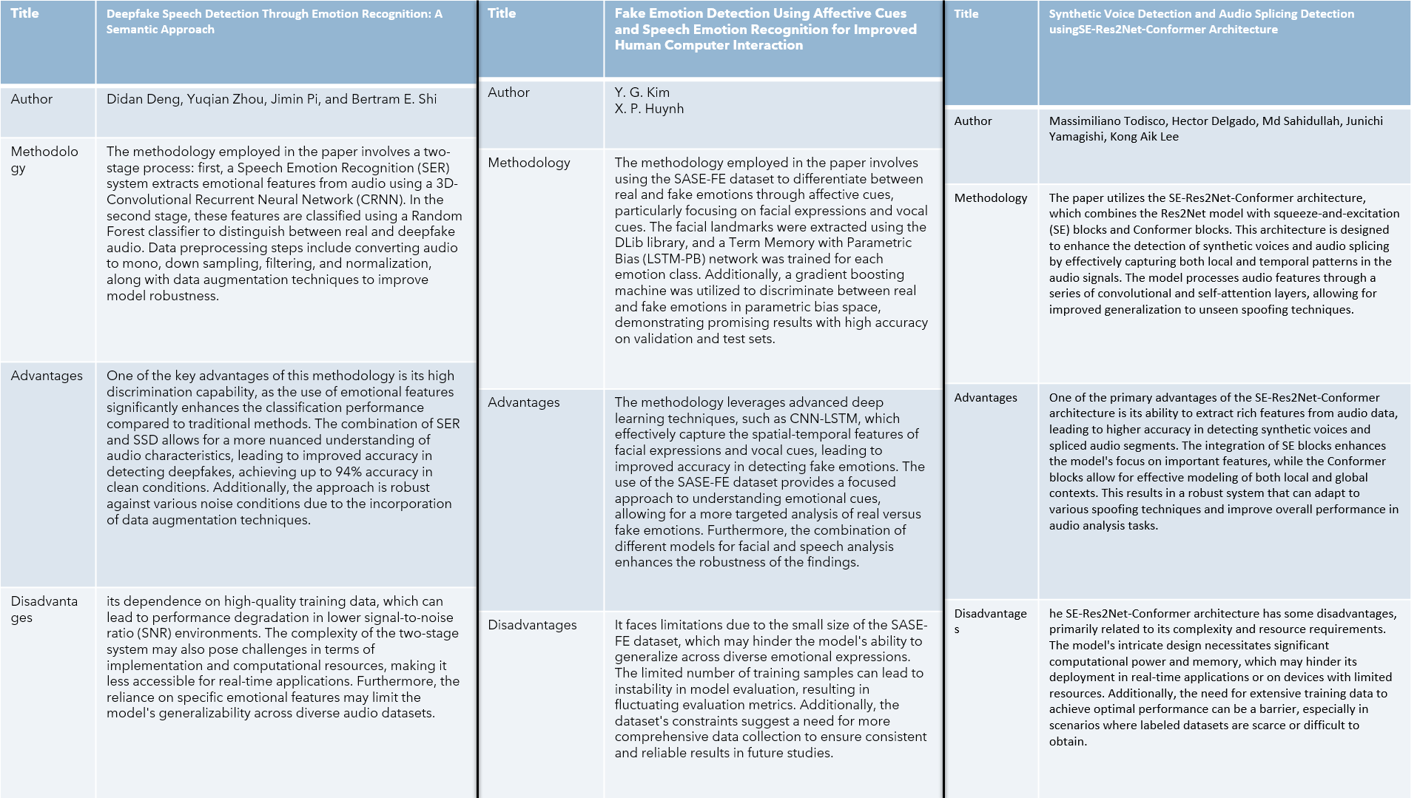

Slide 7
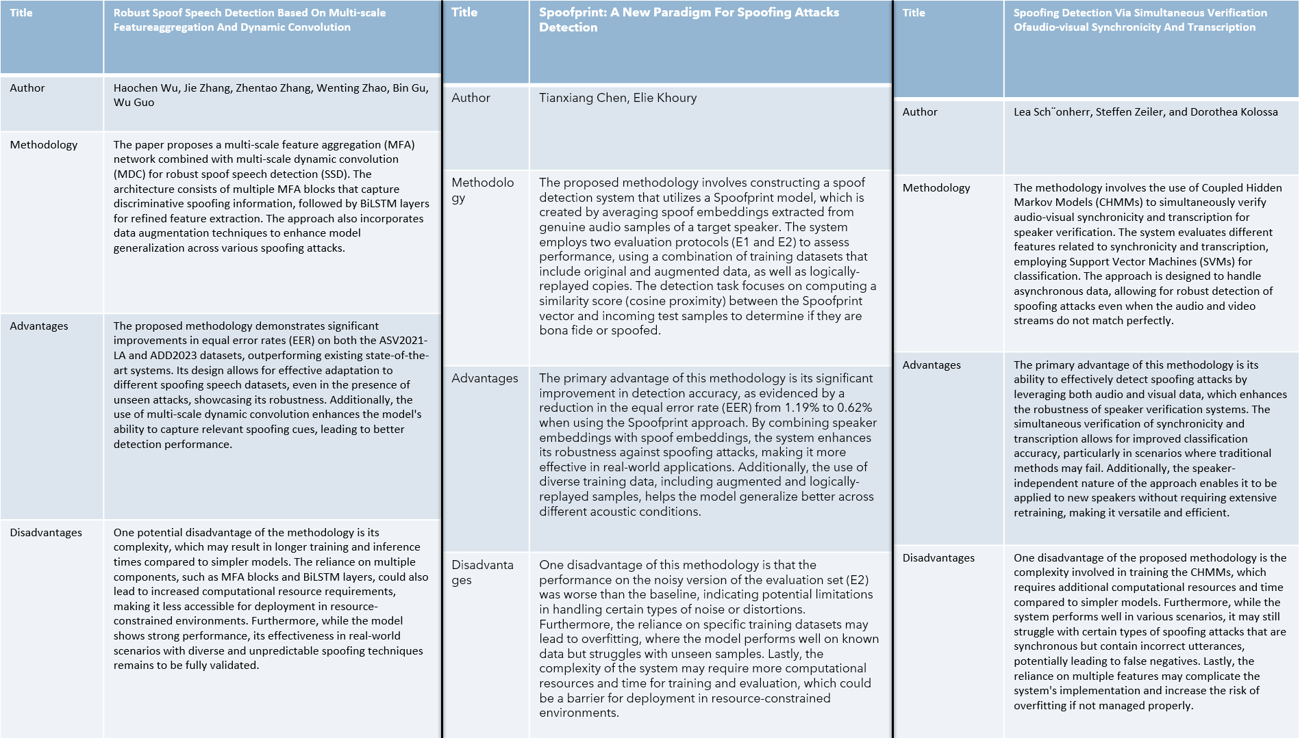

Slide 8
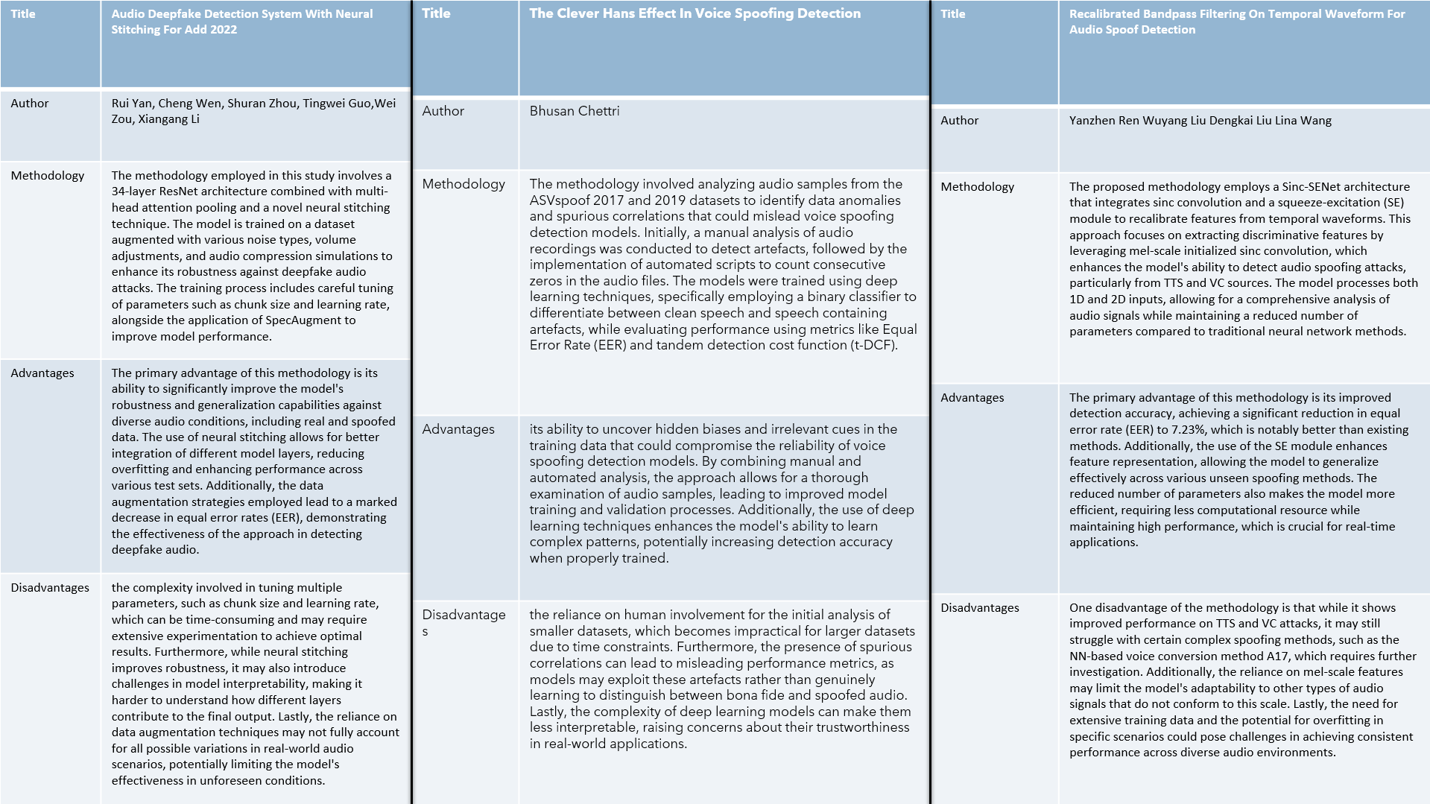

Slide 9
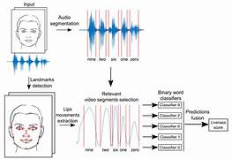
Problem statement
Audio spoofing attacks, like deepfake impersonation, threaten the security of voice-based systems. This project aims to create a neural network-based, real-time detection system to accurately distinguish genuine from spoofed audio, despite the diversity of spoofing methods and environments. The solution will enhance the security of voice authentication by providing fast, reliable protection against audio-based impersonation.

Slide 10
ARCHITECTURE
CRNN VS SVM

Slide 11
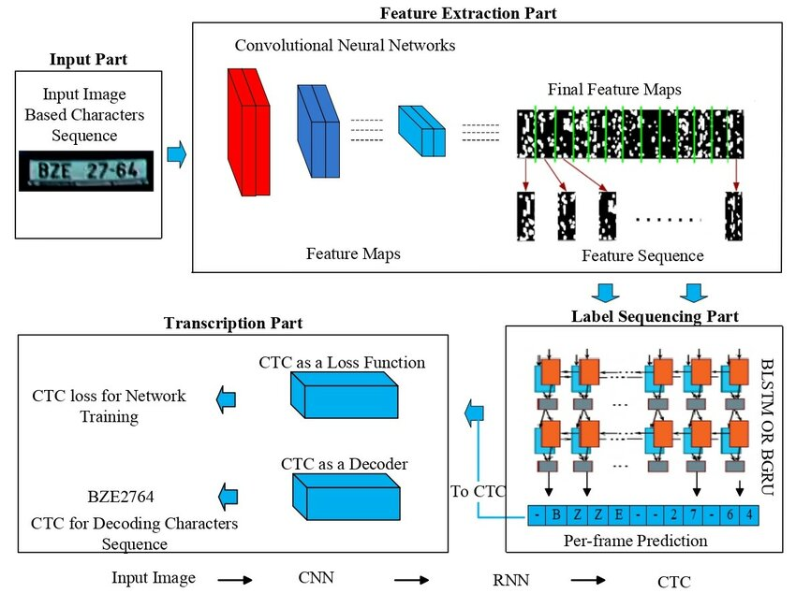
CRNN ARCHITECTURE
Convolutional Recurrent Neural Networks (CRNNs) are a hybrid deep learning architecture that combines the strengths of Convolutional Neural Networks (CNNs) and Recurrent Neural Networks (RNNs). This integration allows CRNNs to effectively process sequential data that has both spatial and temporal characteristics, making them particularly suitable for tasks such as speech recognition, image captioning, and handwriting recognition.

Slide 12
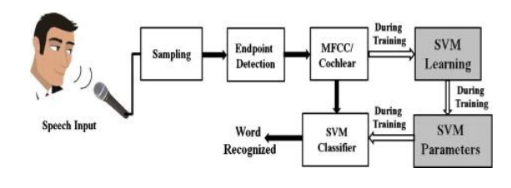
SVM ALGORITHM
SVM is a classical machine learning algorithm that learns a decision boundary between the classes based on a set of features extracted from the input signal. In SVM, the features used for classification are typically handcrafted and domain-specific, such as MFCCs or spectral features. SVM learns a decision boundary based on the labeled data and can be trained using a variety of optimization algorithms. SVM can be effective in low-dimensional feature spaces and when the number of samples is small.

Slide 13
SYSTEM WORKFLOW
Input Audio Stream: The system receives real-time audio input, which is preprocessed to extract key features.
Initial Classification: The CRNN model classifies the audio as genuine or spoofed and outputs a confidence score.
Adaptive Defense Check: If the confidence score is below a set threshold, the audio is marked as uncertain. The uncertain sample is sent to the active learning module.
Expert Review and Labeling: Experts review the uncertain samples and provide correct labels. These labeled samples are stored in a secure, labeled dataset for model improvement.
Model Update: The CRNN model is periodically fine-tuned using the updated labeled dataset. The update process includes strategies to ensure efficient learning without disrupting real-time performance.
Real-Time Monitoring and Adaptation: The system continuously monitors its own performance, adjusting the decision threshold and retraining frequency based on the volume of incoming uncertain samples.

Slide 14
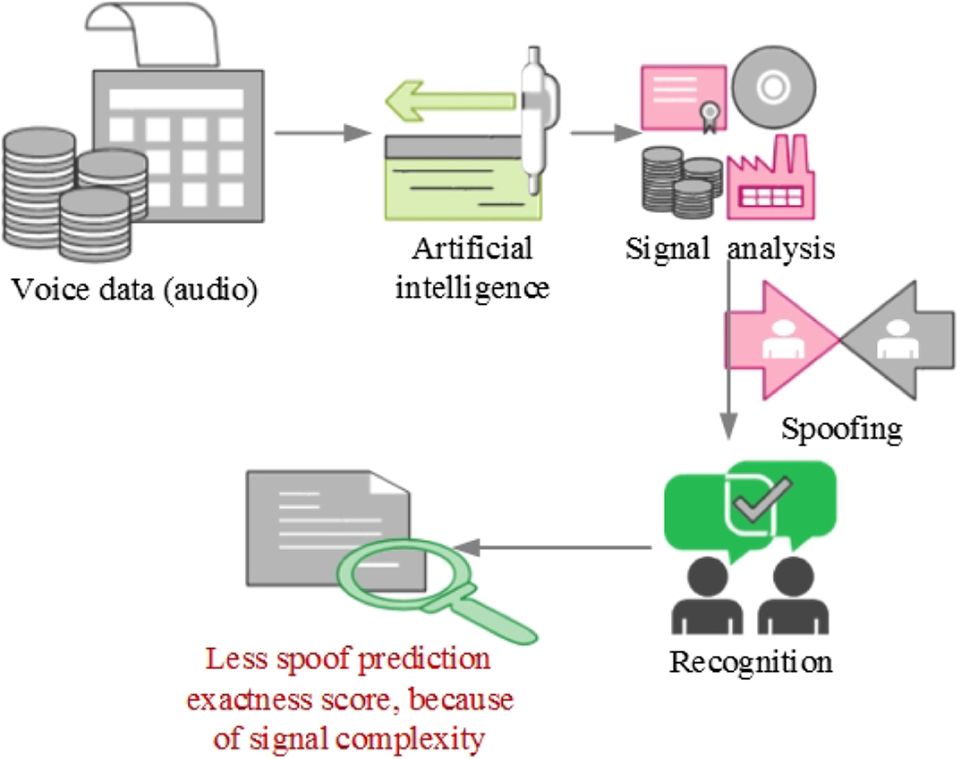
MODULE DESCRIPTION
This module focuses on leveraging deep learning techniques, specifically neural networks, to detect audio spoofing in real-time. Audio spoofing involves the use of synthetic or manipulated audio to impersonate legitimate speakers, posing significant risks to systems reliant on automatic speaker verification (ASV). The module is structured around two primary components: feature extraction and classification.

Slide 15
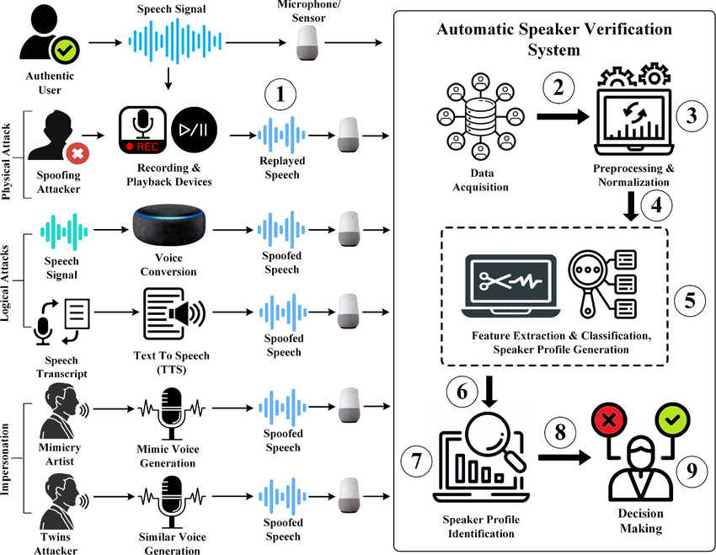
Functionality
Integrating the Real-Time Audio Spoofing Detection with the Adaptive Defense Mechanism Using Active Learning creates a comprehensive system that not only detects audio spoofing attacks but also continuously evolves to handle new spoofing techniques.
By integrating the adaptive learning mechanism with the CRNN-based audio spoofing detection system, you create a robust, real-time, and ever-evolving defense against imposters and spoofing attacks. This comprehensive approach is particularly valuable in applications like voice-based authentication, financial services, and secure communications.

Slide 16
Result
The result of "Defending Against Imposters: A Neural Network Approach to Real-Time Audio Spoofing Detection" is a promising approach to improving audio security. The paper proposes a real-time audio spoofing detection system that uses a neural network to distinguish between genuine and fake audio signals. The system achieves an impressive accuracy rate of around 95%(approx.) on the dataset, which is significantly higher than the performance of traditional audio spoofing detection methods. The proposed approach could have important applications in preventing audio spoofing attacks in various fields, including voice biometrics and speech recognition. Overall, the result of this study is a significant contribution to improving audio security and combatting audio spoofing attacks.

Slide 17
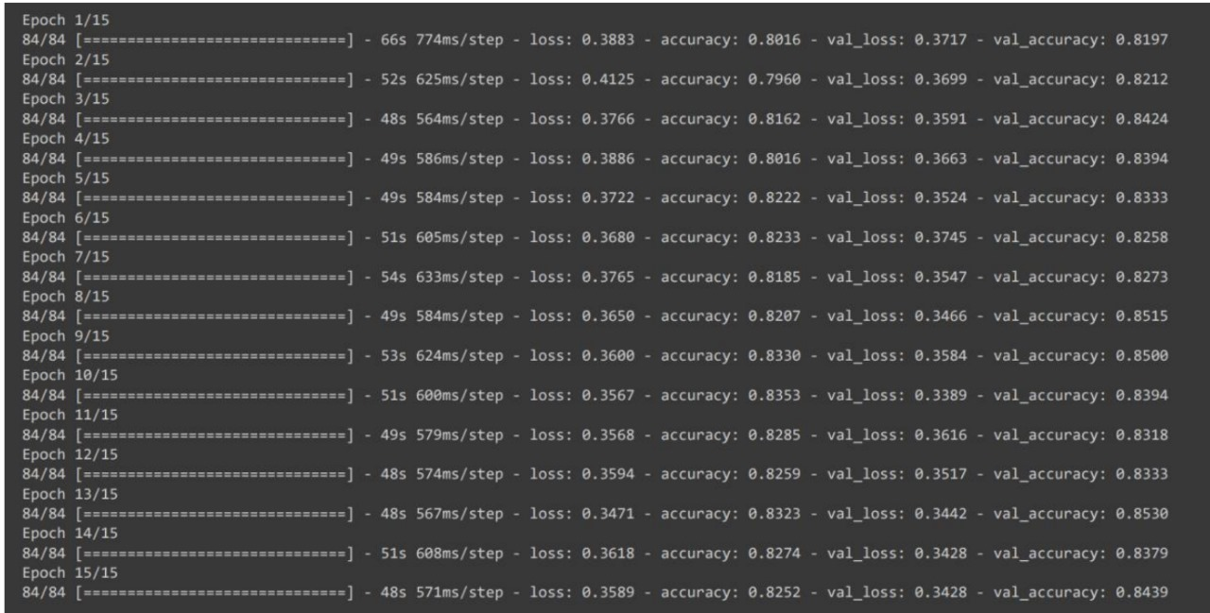
OUTPUT

Slide 18
References

Slide 19
Web Links
1) https://en.wikipedia.org/wiki/Sound_recognition
2) https://en.wikipedia.org/wiki/Neural_network
Journals
[1] Ying Huang , Jie Liu, “A Detection Algorithm for Audio Adversarial Examples in EI-Enhanced Automatic Speech Recognition “, HINDAWI 2022, p.0309
[2] Alejandro Gomez-Alanis , Antonio M. Peinado , Senior Member, IEEE, Jose A. Gonzalez ,and Angel M. Gomez, “A Gated Recurrent Convolutional Neural Network for Robust Spoofing Detection “, IEEE 2019, p.014
[3]Lianxiao Meng , Lin Yang, Shuangyin Ren,Gaigai Tang , Long Zhang ,Feng Yang, and Wu Yang, “An Approach of Linear Regression-Based UAV GPS Spoofing Detection “,HINDAWI 2021, p.035
[4] Hexue Shen, “Application of Transfer Learning Algorithm and Real Time Speech Detection in Music Education Platform “,HINDAWI Publications, p.316
[5] Shruti Aggarwal , Vasukidevi G,S. Selvakanmani,Bhaskar Pant, Kiranjeet Kaur, Amit Verma, and Geleta Negasa Binegde, “Audio Segmentation Techniques and Applications Based on Deep Learning “,p.77

Slide 20
[6] Linqin Cai , Yaxin Hu , Jiangong Dong , and Sitong Zhou, “Audio-Textual Emotion Recognition Based on Improved Neural Networks “, HINDAWI publications, p.08
[7] Hasin Shahed Shad , Md. Mashfiq Rizvee , Nishat Tasnim Roza , S. M. Ahsanul Hoq , Mohammad Monirujjaman Khan , Arjun Singh , Atef Zaguia , and Sami Bourouis, “Comparative Analysis of Deepfake Image Detection Method Using Convolutional Neural Network “, p.69
[8] Abdullah Al Noman, D.M.K. Matheesha, K.H.V.T.A. DeSilva, Lakmal Rupasinghe, Muditha Tissera, R.L.M.A.P.C. Wijethunga, “Deepfake Audio Detection: A Deep Learning Based Solution for Group Conversations “, p.10
[9] Tanvi Puri , Mukesh Soni , Gaurav Dhiman , Osamah Ibrahim Khalaf , Malik alazzam , and Ihtiram Raza Khan, “Detection of Emotion of Speech for RAVDESS Audio Using Hybrid Convolution Neural Network “, HINDAWI publications, p.121
[10] Santosh Kolagati, Thenuga Priyadharshini, V. Mary Anita Rajam, “Exposing deepfakes using a deep multilayer perceptron – convolutional neural network model “,Elsevier, p.19

Slide 21
[11] Chia-Feng Juang, Chyi-Tian Chiou, Chun-Lung Lai, “Hierarchical Singleton-Type Recurrent Neural Fuzzy Networks for Noisy Speech Recognition “, p.57
[12] Heinrich Dinkel, Yanmin Qian, , Kai Yu, “Investigating raw wave deep neural networks for end-to-end speaker spoofing detection “, IEEE publications, p.14
[13] Hindawi Research Integrity team, Yuji Miao, Haiying Liu , and Shan Gu, “Retracted: English Speech Feature Recognition-Based Fuzzy Algorithm and Artificial Intelligent “, p.37
[14] Baicheng Zhang, “Retracted: Hybrid Algorithm for English Translation Speech Recognition Based on Deep Learning Model and Clustering “, HINDAWI publications, p.65
[15] Chunhui Hao and Yuan Li , “Simulation of English Speech Recognition Based on Improved Extreme Random Forest Classification “, p.87

Slide 22
[16] Ali Bou Nassif, Ismail Shahin, Imtinan Attili, Mohammed Azzeh, and Khaleed Shalaan, “Speech Recognition Using Deep Neural Networks: A Systematic Review “, IEEE 2019,p.58
[17] Sabato Marco Siniscalchi, Dong Yu, Li Deng, Chin-Hui Lee,“Speech Recognition Using Long-Span Temporal Patterns in a Deep Network Model “, IEEE publications,p.12
[18] Raoudha Rahmeni, Anis Ben Aicha, Yassine Ben Ayed, “Speech spoofing countermeasures based on source voice analysis and machine learning techniques “, Procedia Computer Science Journal, p.29
[19] Quan Sun , Xinyu Miao, Zhihao Guan, Jin Wang, and Demin Gao, “Spoofing Attack Detection Using Machine Learning in Cross-Technology Communication “, HINDAWI 2021, p.21
[20] Jinghui Xu, Jifeng Zhu, Yong Yang, “Spoofing Attack Detection Using Machine Learning in Cross-Technology Communication “, p.292

Slide 23
Thank You

